Slide 1
Lecture No. 28 Metallurgy
At the end of this lecture, students will be able to:
Explain the importance of metallurgy
Discuss the types of metallurgy
Describe the processes of metallurgy

Slide 2
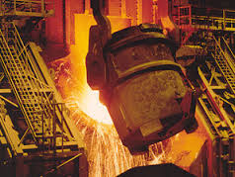
Introduction
Metallurgy:
Extraction of a metal in its pure form from
any ore
Ores contain unwanted impurities and the required metal in different amounts
Metallurgy involves extraction of pure metal by physicals and chemical processes
Also involves Study of physical and chemical behaviour of metals and their compounds.

Slide 3
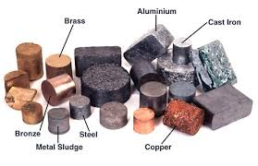
Introduction
Ores:
Ores are minerals from which metals are extracted at low cost and minimum effort
Types of Metallurgy:
Metallurgy
Ferrous metallurgy (iron and alloys of iron)
E.g., Fe from haematite ore
Non-ferrous metallurgy (except iron includes other metals and their alloys)
E. g., Al from bauxite ore
Pyrometallurgy
Hydrometallurgy
Electrometallurgy

Slide 4
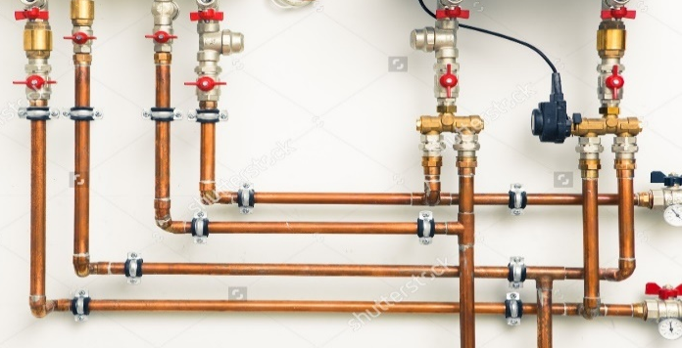

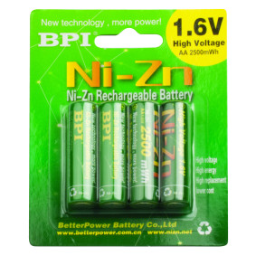
Applications of metals
Metals obtained from ores in pure form are useful for various application,
Fe is useful in automobiles, hardware, cookware, cutting tools etc.
Cu is used to make electrical wires, utensils, boiler pipes etc.
Al is used to make foils, containers, automobile parts etc.
Zn is useful for galvanizing (anticorrosion), battery production etc.

Slide 5
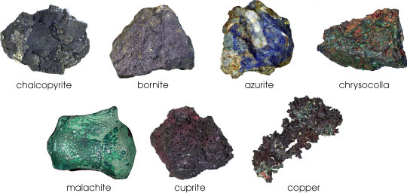
Occurrence of elements
1. Native state:
Elements are found in their elementary form or in uncombined state
E.g., Au, Ag, Cu, Pt etc.
2. Combined state:
found in the form of their compounds
E.g., metal oxides, sulphides, silicates etc.
3. Minerals and ores:
Minerals: metals in combined form are found in the earth
Ores: minerals forms (concentrations of minerals) from which metal can be extracted economically and conveniently
All minerals are not ores but all ores are minerals

Slide 6
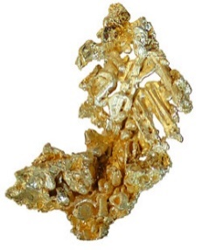
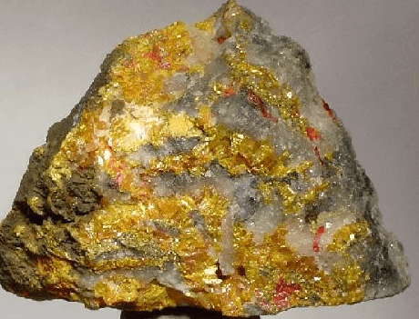
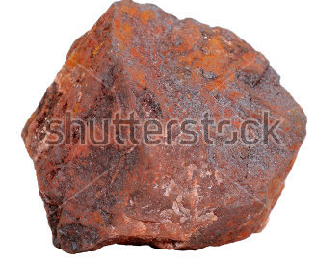
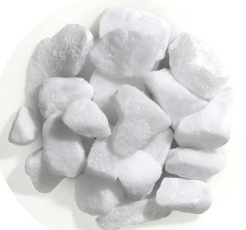
Types of ores
Native ores: metals are in free state, e.g., Au, Ag, Cu, Hg, Bi etc.
Sulphide ores: occur as sulphides, e.g., Zinc blunde (ZnS), galena (PbS), cinnabar (HgS), chalcopyrite (CuFeS₂) etc.
Oxide ores: occur as oxides, e.g., bauxite (Al₂O₃.2H₂O), cuprite (Cu₂O), haematite (Fe₂O₃), magnetite (Fe₃O₄) etc.
Carbonate ores: occur as carbonates, e.g., magnesite (MgCO₃), lime stone (CaCO₃), dolomite (CaCO₃.MgCO₃) etc.

Slide 7
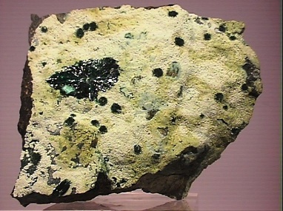
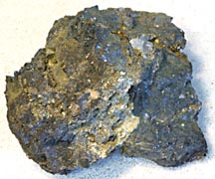
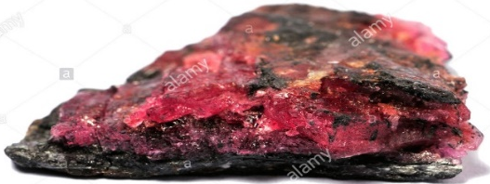
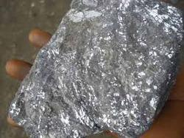
Types of ores
Halide ores: occur as halides, e.g., rock salt (NaCl), sylvine (KCl), horn silver (AgCl), fluorspar (CaF₂) etc.
Sulphate ores: occur as sulphates, e.g., barite (BaSO₄), gypsum (CaSO₄. 2H₂O), anglesite (PbSO₄) etc.
Silicate ores: occur as silicates, e.g., spodumene [LiAl (SiO₃)₂], potash feldspar (K₂O.Al₂O₃.6SiO₂), beryl (3Beo.Al₂O₃.6SiO₂) etc.
Nitrate ores: occur as nitrates, e.g., caliche (NaNO₃), nitre (KNO₃) etc.

Slide 8
Steps of Metallurgy
Pulverization of ore (Size reduction)
Concentration of ore
Calcination & roasting
Reduction of ore into metal
Refining / Purification of metal

Slide 9
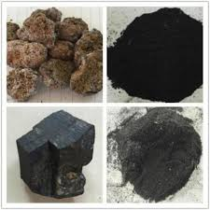
Pulverization/Size reduction of ore
Ores occur as huge lumps in nature
These lumps are broken into small pieces and further converted into fine powders
It leads to an increase in surface area per unit volume which enhances the rate of the reaction by allowing more sites for the reaction to take place
Moreover handling of smaller size particles is much easier as compared to that of bigger particles

Slide 10
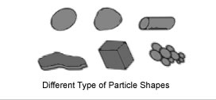
Pulverization/Size reduction of ore
Compression or crushing is generally used for reduction of hard solids to coarse sizes
Impact gives coarse, medium, or fine sizes
Attrition or rubbing yields fine products
Cutting gives definite sizes

Slide 11
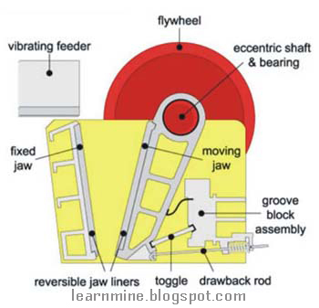
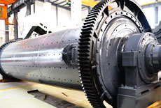
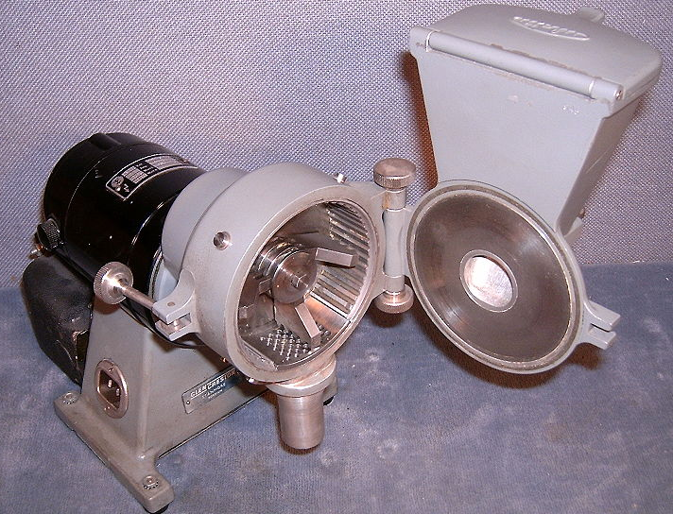
Equipment for size reduction
Crushers like jaw crushers, gyratory crushers, etc. are used for coarse and fine size reduction
Cutting machines like knife cutters, slitters, dicers are used to get required sizes
Grinders like hammer mills, rolling-compression mills etc. are used for intermediate and fine size reduction
Ultrafine grinders like agitated mills, fluid-energy mills, etc.
Jaw crusher
Agitated ball mill
Hammer mill

Slide 12
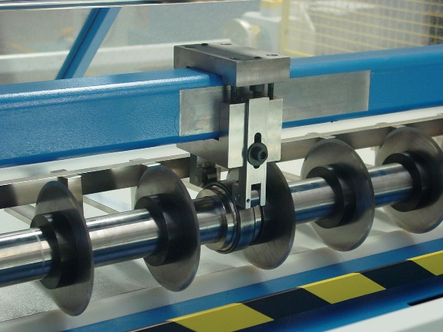
Equipment for size reduction
Equipment for size reduction may be classified based on the forces applied
Force applied between two surfaces (as in crushing and shearing)
Force applied on one solid surface (as in impact breaking)
By action of surrounding medium (as in a colloid mill)
More practical classification is to divide equipment into crushers, grinders, fine grinders and cutters
Multiblade Slitter

Slide 13
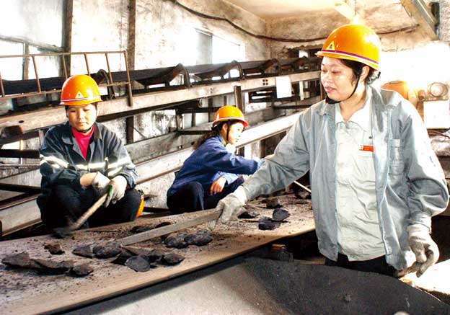
Concentration of ore
Concentration is a process to remove impurities (gangue) such as earthy matter, rocky matter, sand, lime stone etc.
Different types of impurities are removed using various methods depending on their nature
(a) Hand Picking:
If impurities are distinct from the ore and can be easily distinguished then the impurities can be hand picked.
The adhering rocky material can be broken using a hammer and further eliminated.
E.g., haematite ore processing

Slide 14
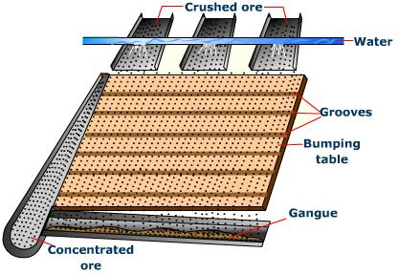
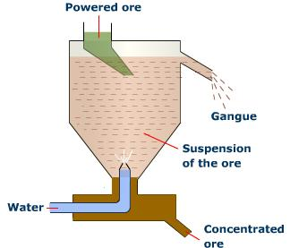
Concentration of ore
(b) Gravity separation:
Utilizes density difference between ore and gangue particles
Removal of impurities which are lighter than ore particles
Powdered ore particles are treated with rapidly flowing current of water
the lighter gangue particles are washed away and heavy ore particles settle down
E.g., haematite Fe₂O₃, tinstone SnO₂

Slide 15
Concentration of ore
(c) Leaching:
Known as we process or hydrometallurgical process
Powdered ore is treated with suitable reagent that can dissolve the ore but not the impurities
Later using suitable method soluble part containing metal ore will be separated from undissolved impurities
E.g., crushed bauxite (Al₂O₃.2H₂O) is heated with hot NaOH which produces soluble aluminum compound and insoluble impurities can be filtered to eliminate
$${Al}_{2}O_{3}.2H_{2}O+2NaOH →2 Na\left[AlO_{2}\right]+3H_{2}O$$

Slide 16
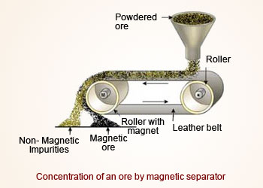
Concentration of ore
(d) Magnetic separation:
Useful when impurities are magnetic and ore particles are non-magnetic or vice-versa
Electromagnetic separator is used which consists of a rubber belt that moves over two rollers one of which encloses a magnet in it
Magnetic particles of the powdered ore are attracted by the magnet and hence fall just below the magnet
Non-magnetic particles fall away, e.g., tin stone SnO₂, chromite (FeO.Cr₂O₃)

Slide 17
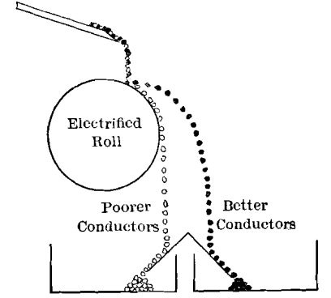
Concentration of ore
(e) Electrostatic separation:
Based on electrostatic attraction and repulsion of conducting particles
In an electrostatic field conducting particles are electrically charged
Charged particles are repelled by the electrode of same charge
E.g., PbS and ZnS mixture can be separated as PbS is a good conductor and it can be charged and thrown away by the roller of same charge.
ZnS being poor conductor drops vertically from the roller

Slide 18
Concentration of ore
(f) Froth flotation:
Metal sulphides are concentrated using this method
To the powdered ore following reagents are added,
1. Frothers: Frothers are added to form stable froth which can rise to the top of the flotation cell.
E.g., Pine oil, camphor oil etc.
2. Collectors: They get attached to the ore particles and make them hydrophobic/water repellant, e.g., xanthates
3. Modifiers: activators or depressents of flotation property of other minerals present as impurities. They help in separation of ore from other mineral impurities.
E.g., NaCN and NaCO₃ depresses the flotation of ZnS and FeS₂ present along with the ore PbS

Slide 19
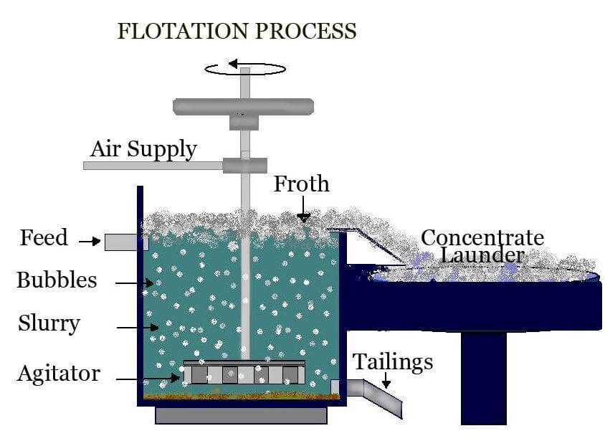
Concentration of ore-Froth flotation
Powdered ore is taken in water along with pine oil
Water is agitated violently with air that leads to froth formation
Ore wetted with oil goes into the hydrophobic part (froth) and rises to the surface which can be collected separately
Gangue particles wetted with water, go into the hydrophilic part and settle down slowly

Slide 20
Summary
Metallurgy is the extraction of pure metal from its ore
It involves the physical and chemical behavior of metals
Metallurgy can be broadly divided into ferrous and non-ferrous metallurgy
Metals occur in native and combined states from which pure metal is extracted
Oxide, sulphide, halide, carbonate, nitrate etc. are different types of minerals
Metallurgy involves various steps
Ore is first in hand pulverized using different methods like crushing, cutting, milling etc.
In the next step ore is concentrated and the impurities are eliminated using different methods

